Slide 1
Matlab HW2 2023.05.01
大氣動力學 (I)

Slide 2
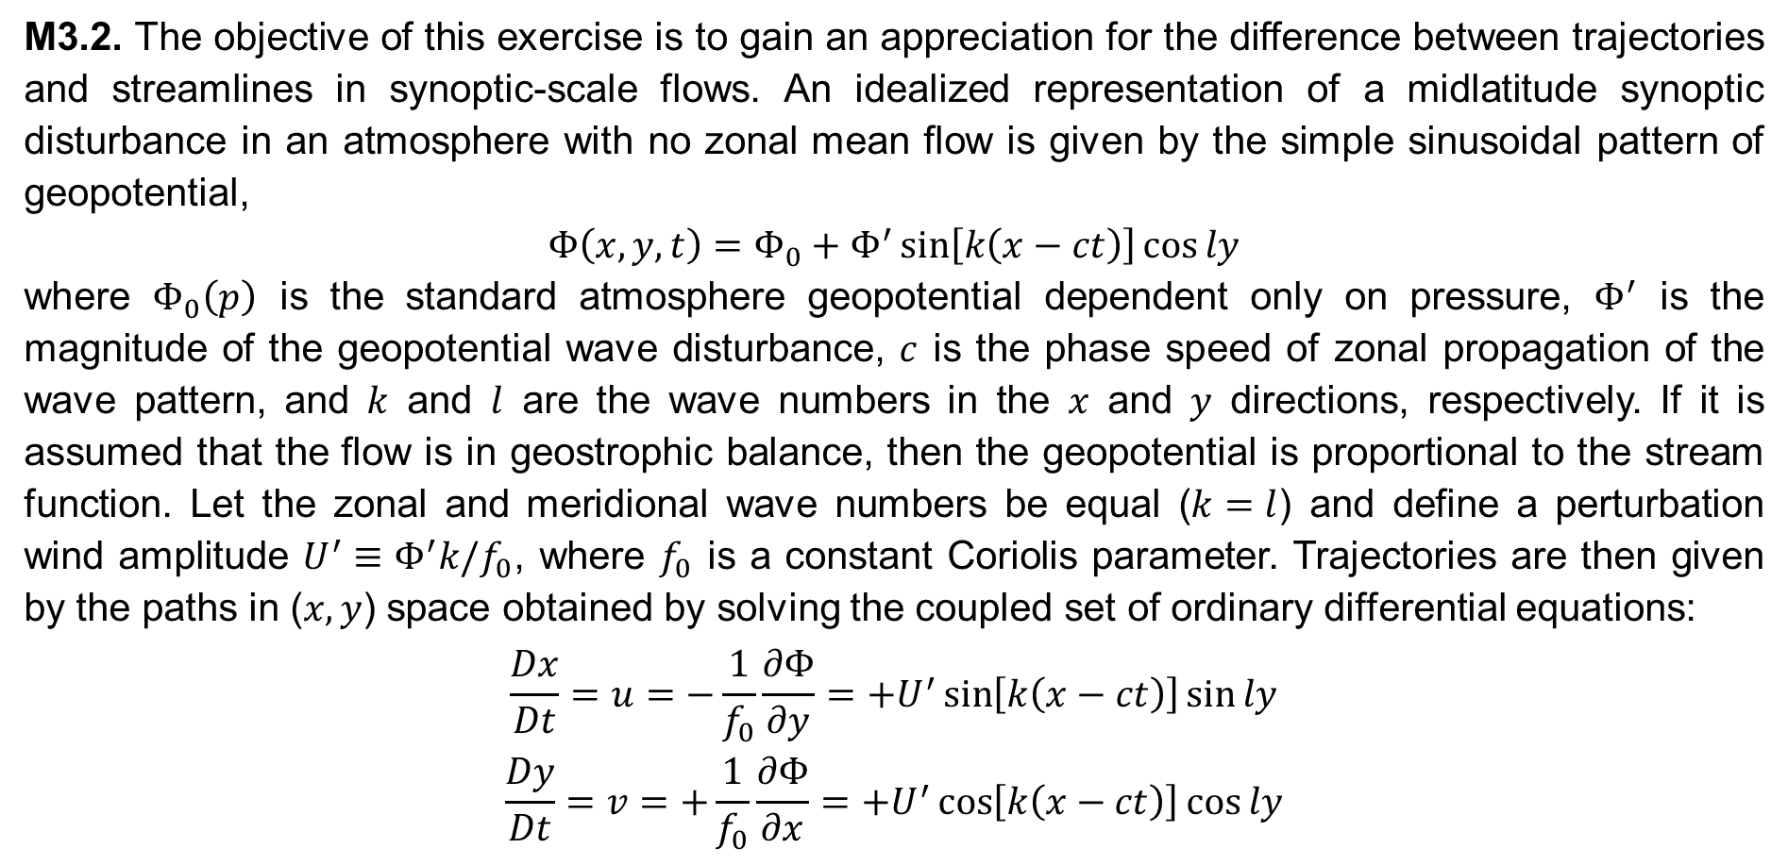
M3.2. The objective of this exercise is to gain an appreciation for the difference between trajectories and streamlines in synoptic-scale flows. An idealized representation of a midlatitude synoptic disturbance in an atmosphere with no zonal mean flow is given by the simple sinusoidal pattern of geopotential,
$$Φ\left(x, y, t\right)=Φ_{0}+Φ^{′}\sin\left[k\left(x−ct\right)\right]\cos{ly}$$
where $Φ_{0}\left(p\right)$ is the standard atmosphere geopotential dependent only on pressure, $Φ^{′}$ is the magnitude of the geopotential wave disturbance, $c$ is the phase speed of zonal propagation of the wave pattern, and $k$ and $l$ are the wave numbers in the $x$ and $y$ directions, respectively. If it is assumed that the flow is in geostrophic balance, then the geopotential is proportional to the stream function. Let the zonal and meridional wave numbers be equal ($k=l$) and define a perturbation wind amplitude $U^{′}≡Φ^{′}k/f_{0}$, where $f_{0}$ is a constant Coriolis parameter. Trajectories are then given by the paths in ($x, y$) space obtained by solving the coupled set of ordinary differential equations:
$$\frac{Dx}{Dt}=u=−\frac{1}{f_{0}}\frac{∂Φ}{∂y}=+U^{′}\sin\left[k\left(x−ct\right)\right]\sin{ly}$$
$$\frac{Dy}{Dt}=v=+\frac{1}{f_{0}}\frac{∂Φ}{∂x}=+U^{′}\cos\left[k\left(x−ct\right)\right]\cos{ly}$$

Slide 3
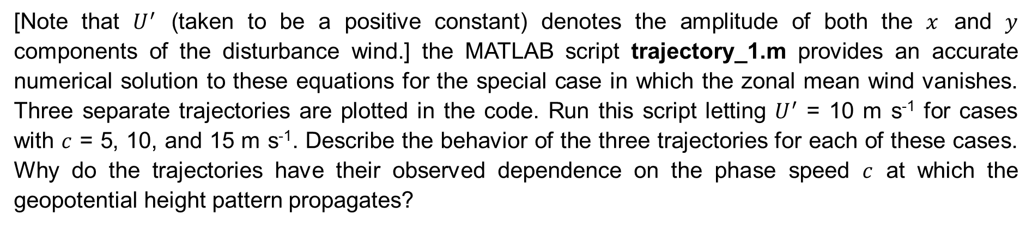
[Note that $U^{′}$ (taken to be a positive constant) denotes the amplitude of both the $x$ and $y$ components of the disturbance wind.] the MATLAB script trajectory_1.m provides an accurate numerical solution to these equations for the special case in which the zonal mean wind vanishes. Three separate trajectories are plotted in the code. Run this script letting $U^{′}$ = 10 m s⁻¹ for cases with $c$ = 5, 10, and 15 m s⁻¹. Describe the behavior of the three trajectories for each of these cases. Why do the trajectories have their observed dependence on the phase speed $c$ at which the geopotential height pattern propagates?

Slide 4

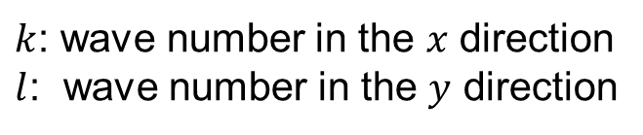


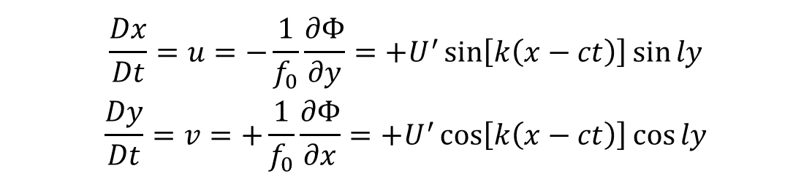
Geopotential disturbance
Phase speed $c$
$$Φ\left(x, y, t\right)=Φ_{0}+Φ^{′}\sin\left[k\left(x−ct\right)\right]\cos{ly}$$
H
L
H
L
H
$$y$$
$$x$$
$k$: wave number in the $x$ direction
$l$: wave number in the $y$ direction
Trajectory
$$\frac{Dx}{Dt}=u=−\frac{1}{f_{0}}\frac{∂Φ}{∂y}=+U^{′}\sin\left[k\left(x−ct\right)\right]\sin{ly}$$
$$\frac{Dy}{Dt}=v=+\frac{1}{f_{0}}\frac{∂Φ}{∂x}=+U^{′}\cos\left[k\left(x−ct\right)\right]\cos{ly}$$

Slide 5
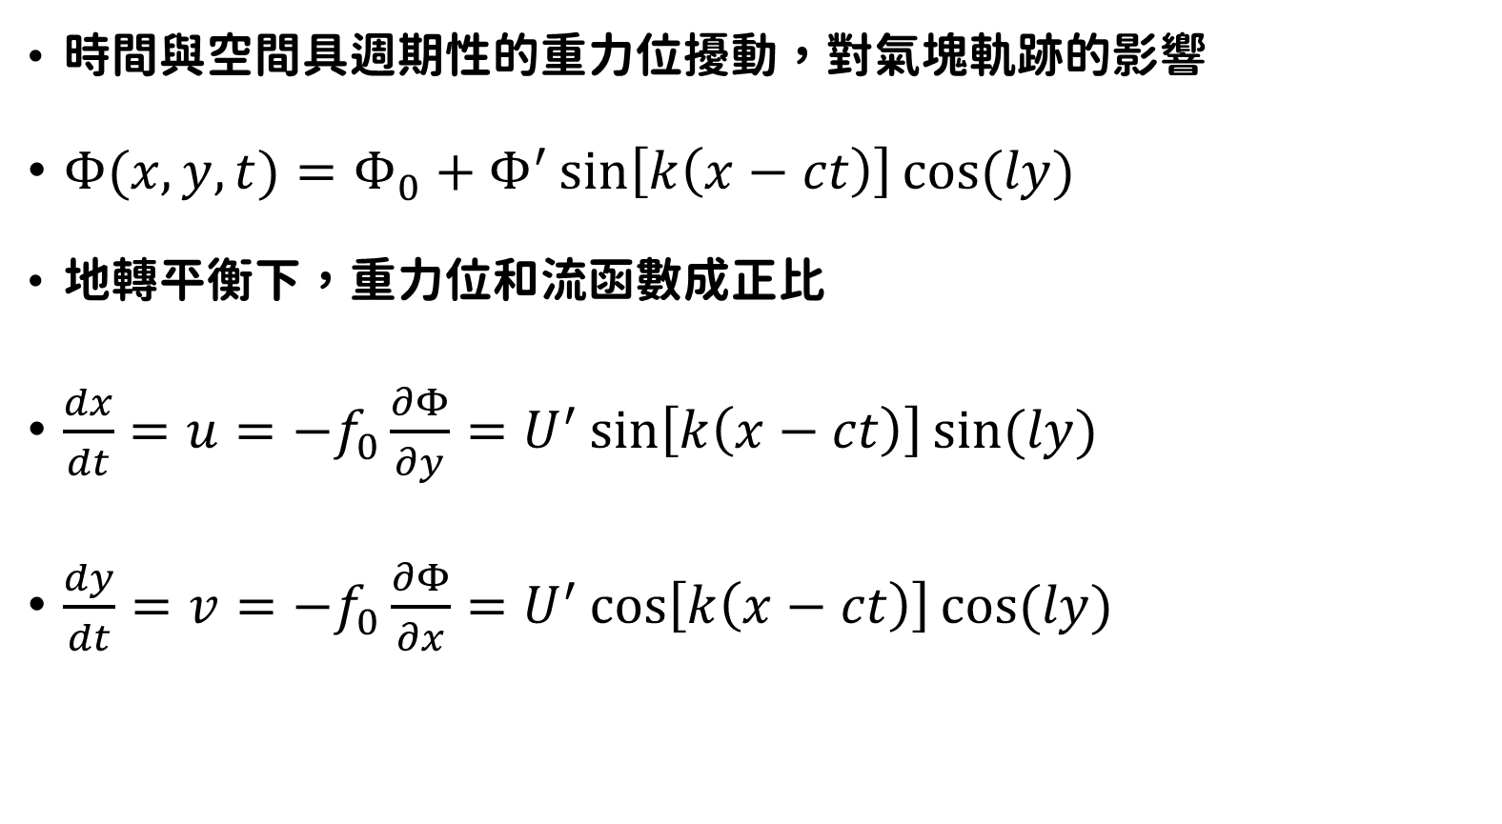
時間與空間具週期性的重力位擾動，對氣塊軌跡的影響
$Φ(x,y,t)=Φ_{0}+Φ^{′}\sin\left[k\left(x−ct\right)\right]cos⁡(ly)$
地轉平衡下，重力位和流函數成正比
$\frac{dx}{dt}=u=−f_{0}\frac{∂Φ}{∂y}=U^{′}\sin\left[k\left(x−ct\right)\right]sin⁡(ly)$
$\frac{dy}{dt}=v=−f_{0}\frac{∂Φ}{∂x}=U^{′}\cos\left[k\left(x−ct\right)\right]cos⁡(ly)$
Φ’: 擾動震幅
k : x方向波數
c : x方向波速
l : y方向波數

Slide 6
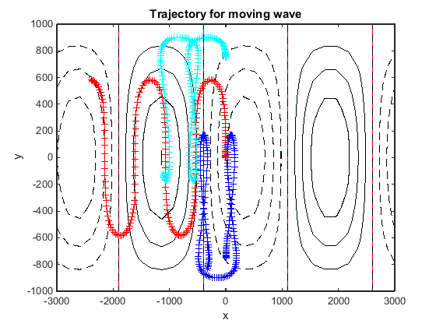
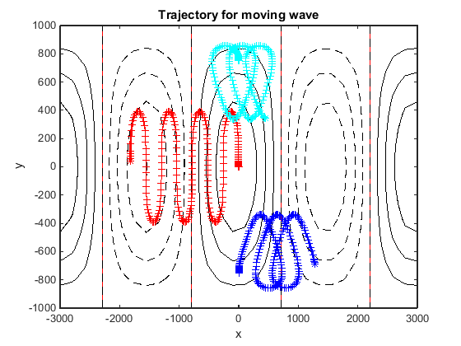
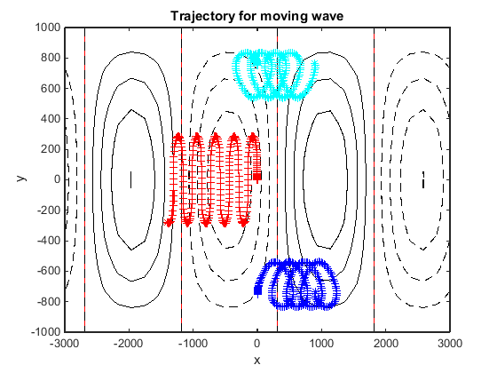



Trajectories for Different Phase Speeds
$$c=5 m s^{−1}$$
$$c=10 m s^{−1}$$
$$c=15 m s^{−1}$$
$$Φ=Φ_{0}+Φ^{′}\sin\left[k\left(x−ct\right)\right]cos⁡(ly)$$

Slide 7
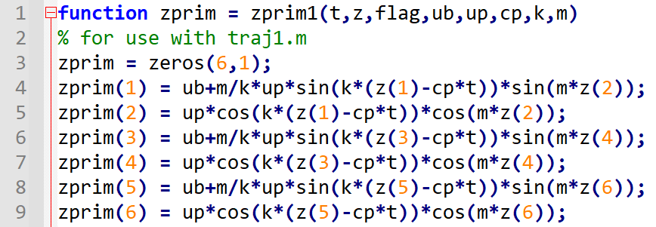
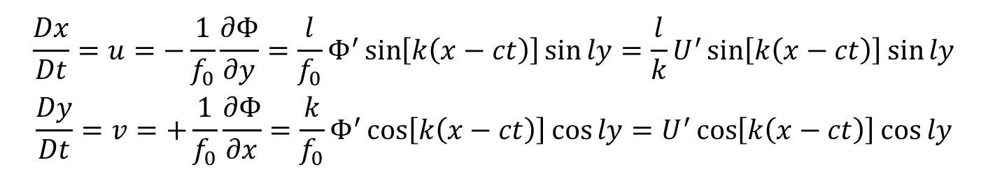
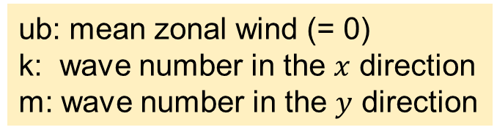

zprim1.m: Set ODE function
ub: mean zonal wind (= 0)
k: wave number in the $x$ direction
m: wave number in the $y$ direction
$$Φ\left(x, y, t\right)=Φ_{0}+Φ^{′}\sin\left[k\left(x−ct\right)\right]\cos{ly}$$
$$U^{′}≡Φ^{′}k/f_{0}$$
$$\frac{Dx}{Dt}=u=−\frac{1}{f_{0}}\frac{∂Φ}{∂y}=\frac{l}{f_{0}}Φ^{′}\sin\left[k\left(x−ct\right)\right]\sin{ly}=\frac{l}{k}U^{′}\sin\left[k\left(x−ct\right)\right]\sin{ly}$$
$$\frac{Dy}{Dt}=v=+\frac{1}{f_{0}}\frac{∂Φ}{∂x}=\frac{k}{f_{0}}Φ^{′}\cos\left[k\left(x−ct\right)\right]\cos{ly}=U^{′}\cos\left[k\left(x−ct\right)\right]\cos{ly}$$

Slide 8
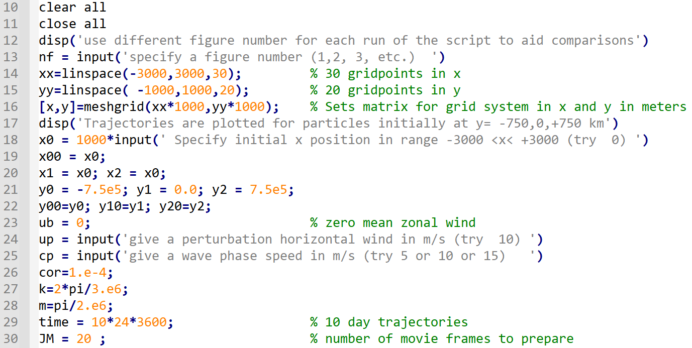
Trajectory_1.m: Set grid points, wind amplitude, phase speed, wave numbers, time, …

Slide 9
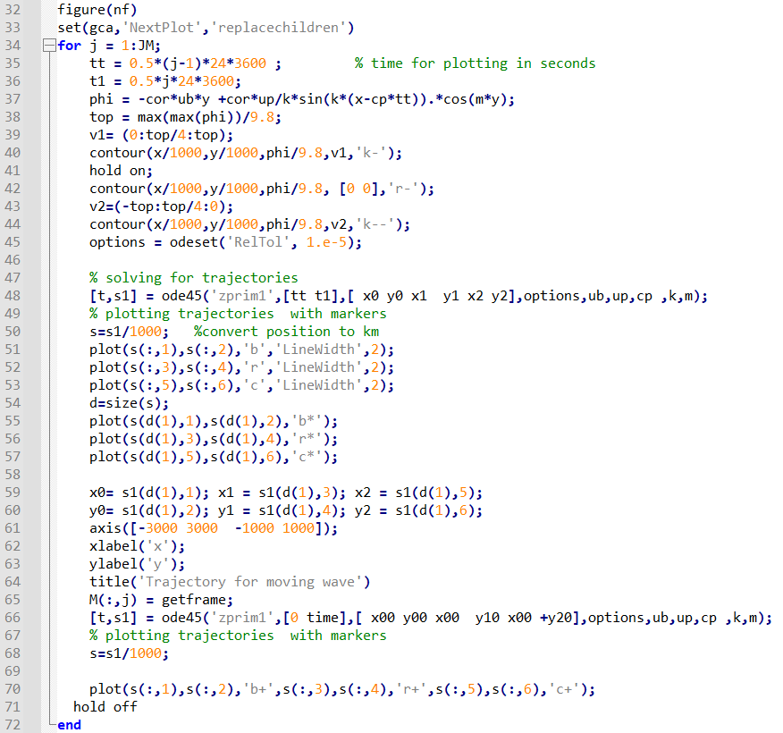
Trajectory_1.m: Solve trajectories & plot

Slide 10
M4.2. The MATLAB scripts geowinds_1.m (to be used when the mapping toolbox is available) and geowinds_2.m (to be used if no mapping toolbox is available) contain contour plots showing the observed 500-hPa height and horizontal wind fields for November 10, 1998, in the North American sector. Also shown is a color plot of the magnitude of the 500-hPa wind with height contours superposed. Using centered difference formulas (see Section 13.2.1), compute the geostrophic wind components, the magnitude of the geostrophic wind, the relative vorticity, the vorticity of the geostrophic wind, and the vorticity minus the vorticity of the geostrophic wind. Following the models of Figures 4.1 and 4.2, superpose these fields on the maps of the 500-hPa height field. Explain the distribution and the sign of regions with large differences between vorticity and geostrophic vorticity in terms of the force balances that were studied in Chapter 3.

Slide 11
實際風（風標、風速）
地轉風（風標、風速）
渦度
地轉渦度
渦度 - 地轉渦度
需自行coding

Slide 12
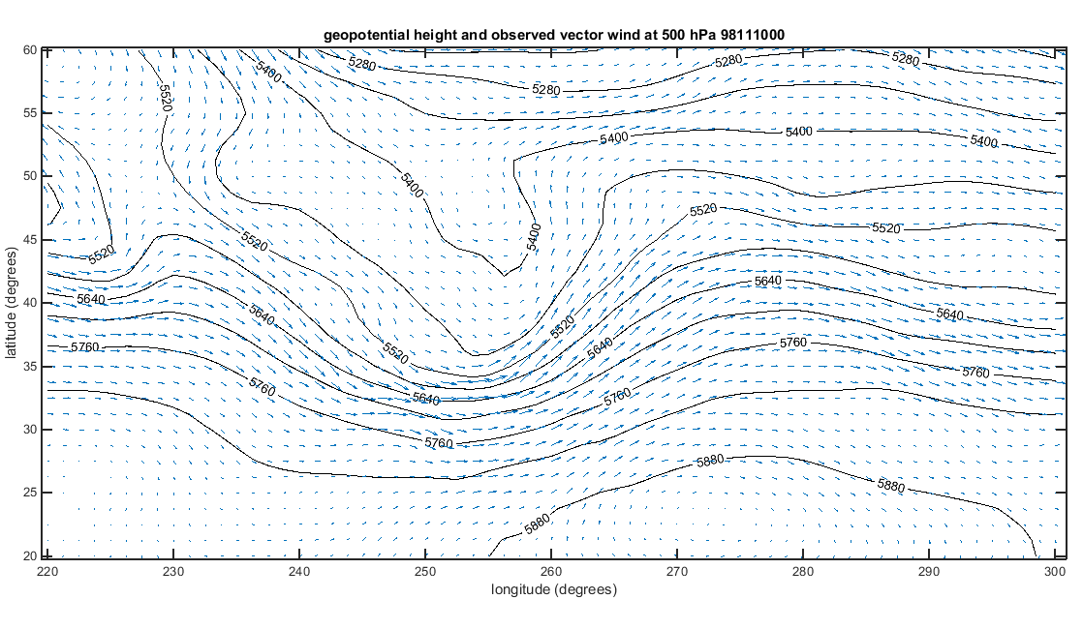
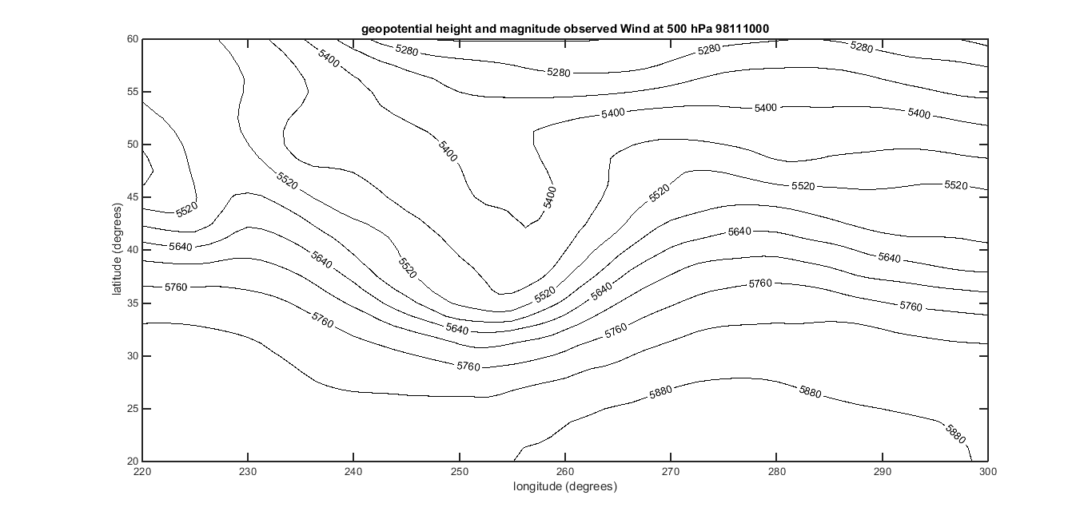
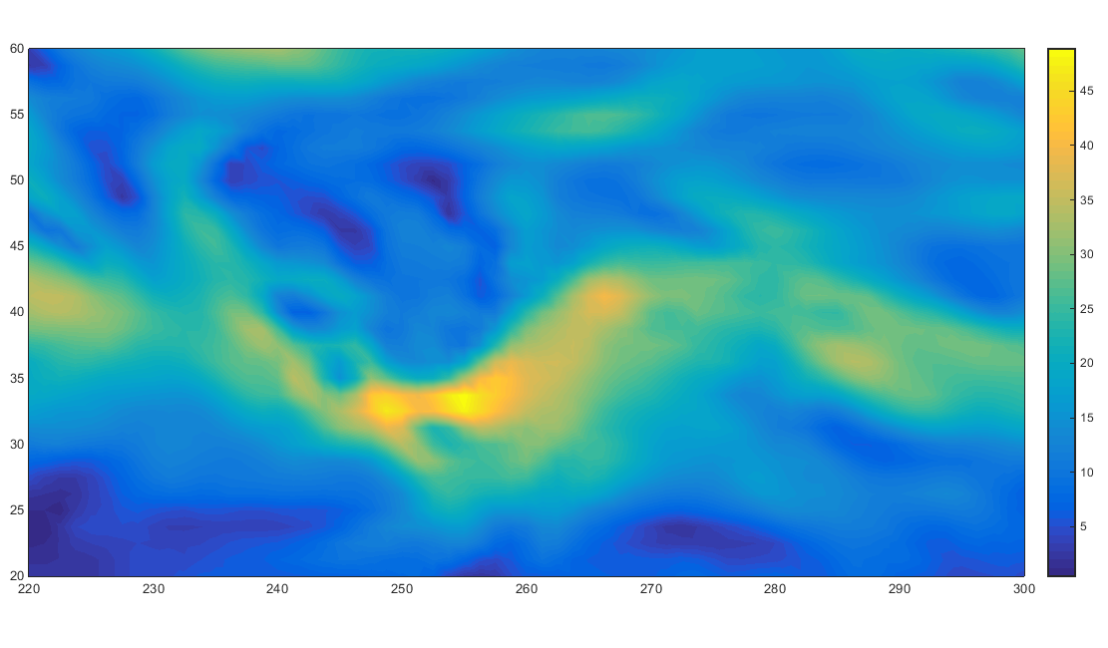
實際風（風標、風速）

Slide 13
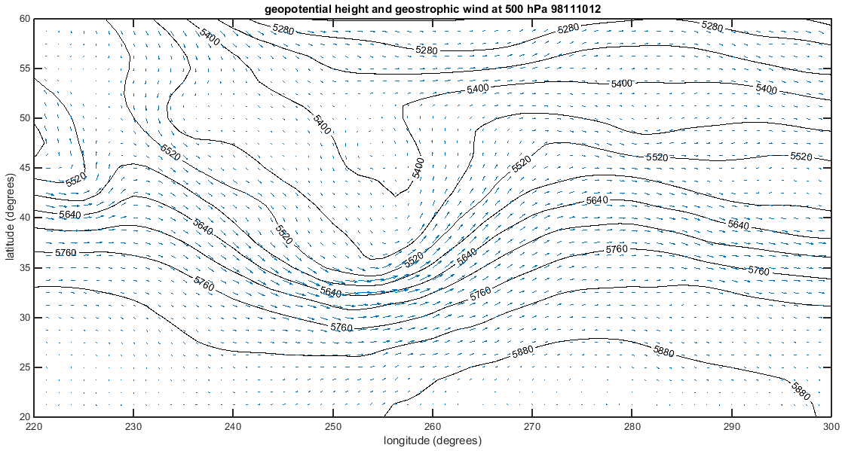
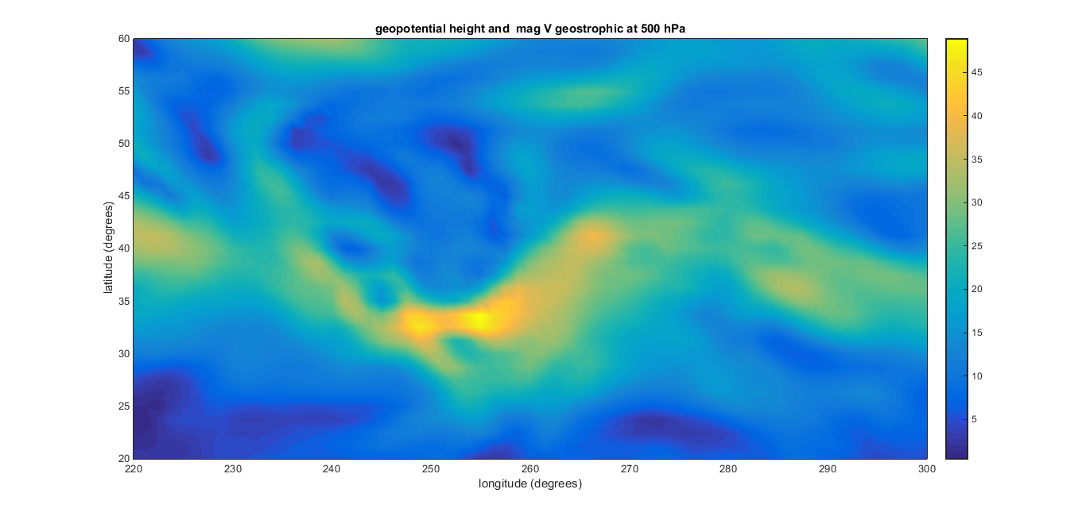
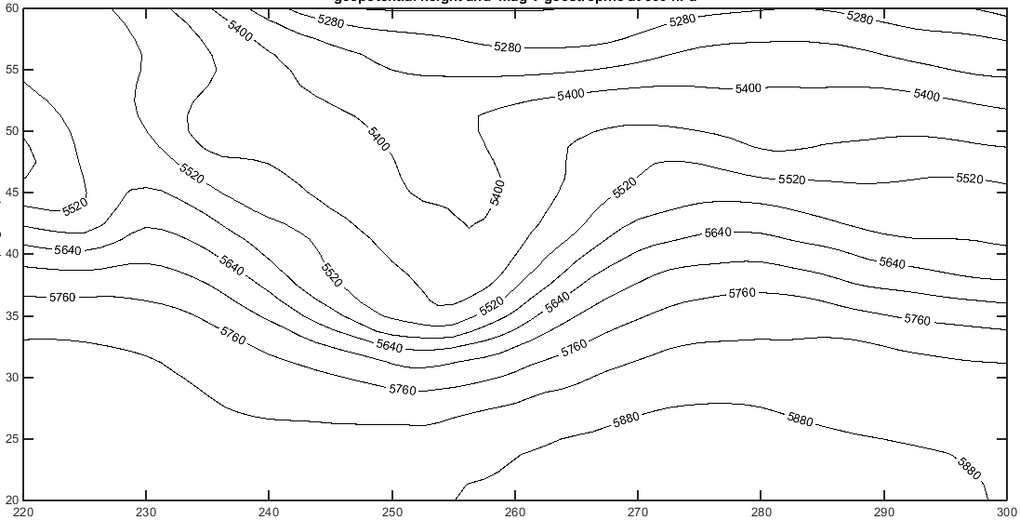
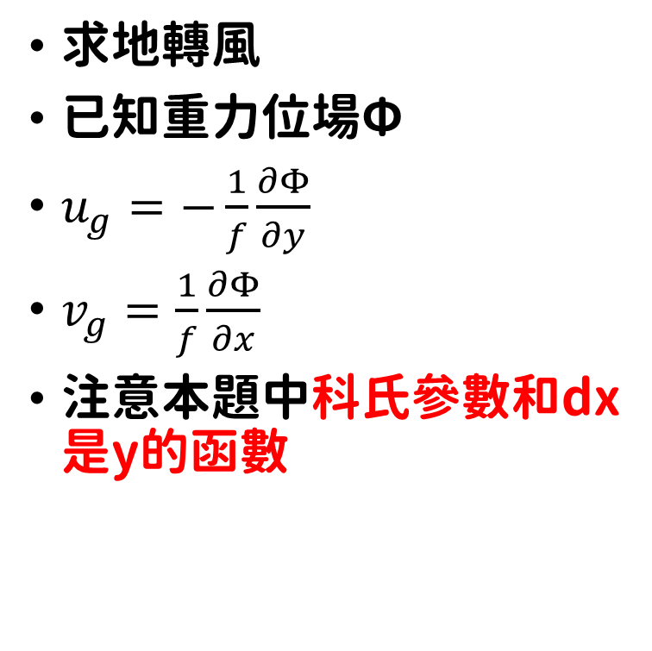
求地轉風
已知重力位場Φ
$u_{g}=−\frac{1}{f}\frac{∂Φ}{∂y}$
$v_{g}=\frac{1}{f}\frac{∂Φ}{∂x}$
注意本題中科氏參數和dx是y的函數

Slide 14
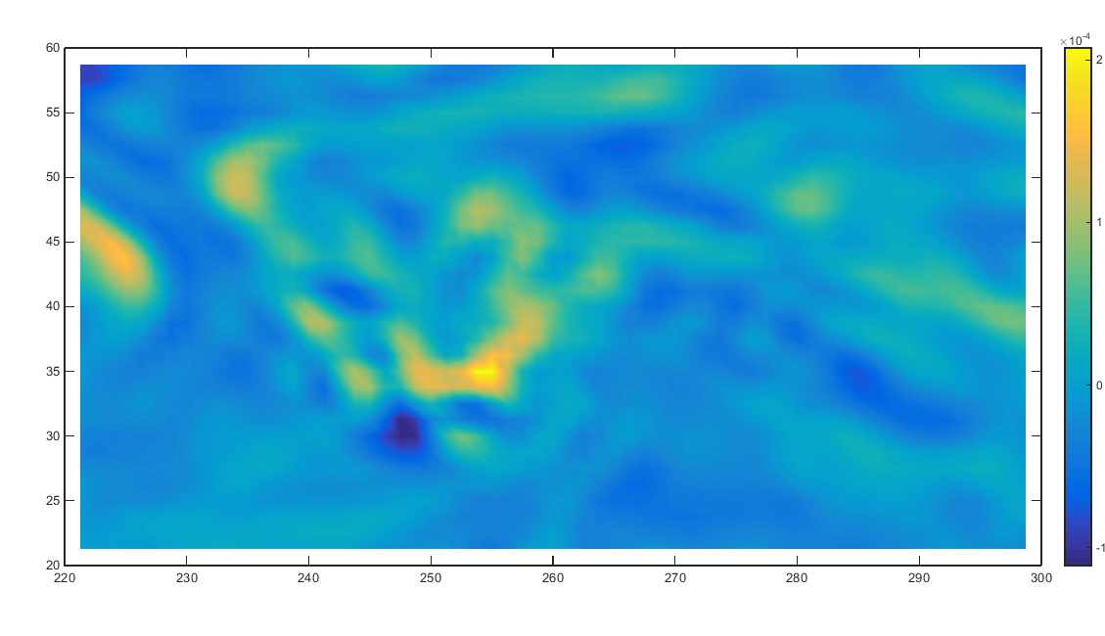
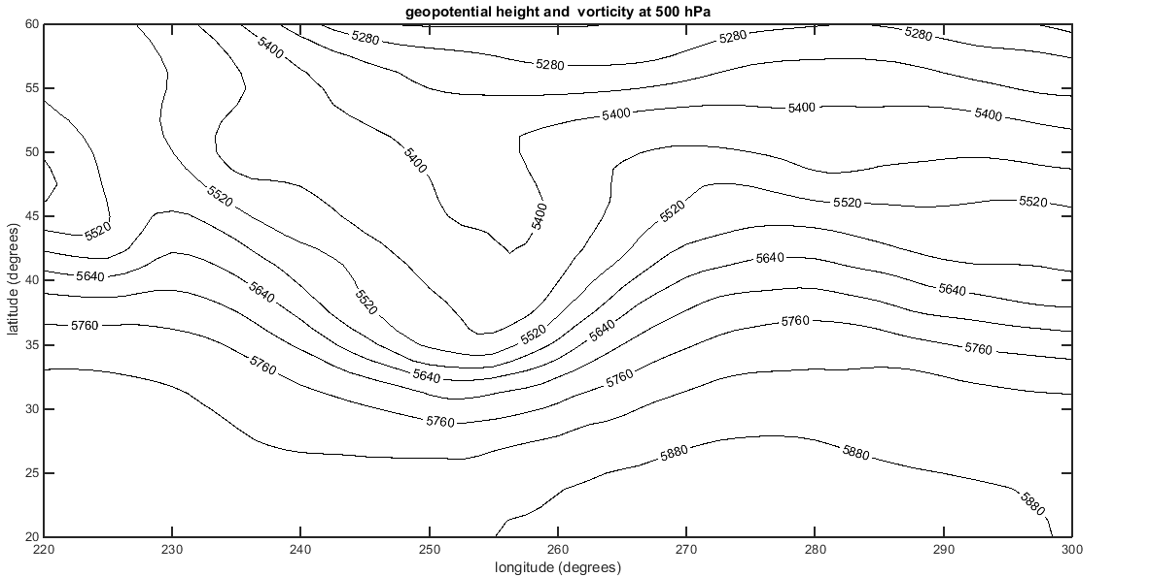

求渦度
已知實際風u, v
$ζ=\frac{∂v}{∂x}−\frac{∂u}{∂y}$

Slide 15
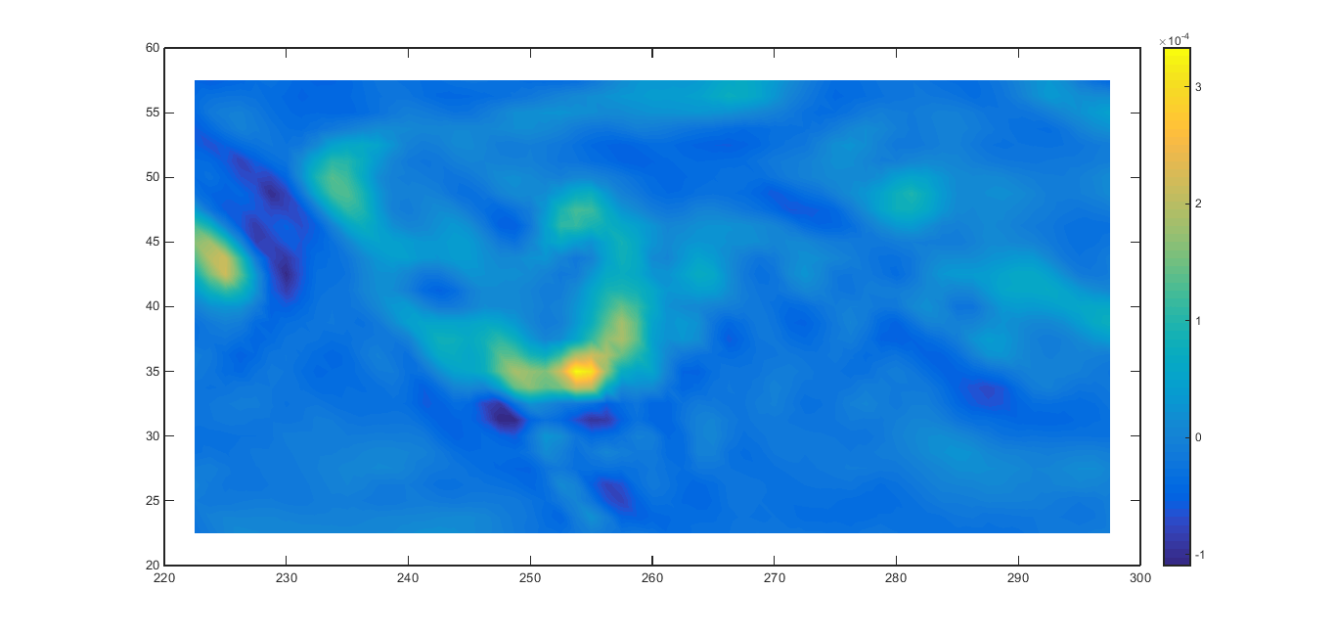

求地轉渦度
已知地轉風ug, vg
$ζ_{g}=\frac{∂v_{g}}{∂x}−\frac{∂u_{g}}{∂y}$

Slide 16
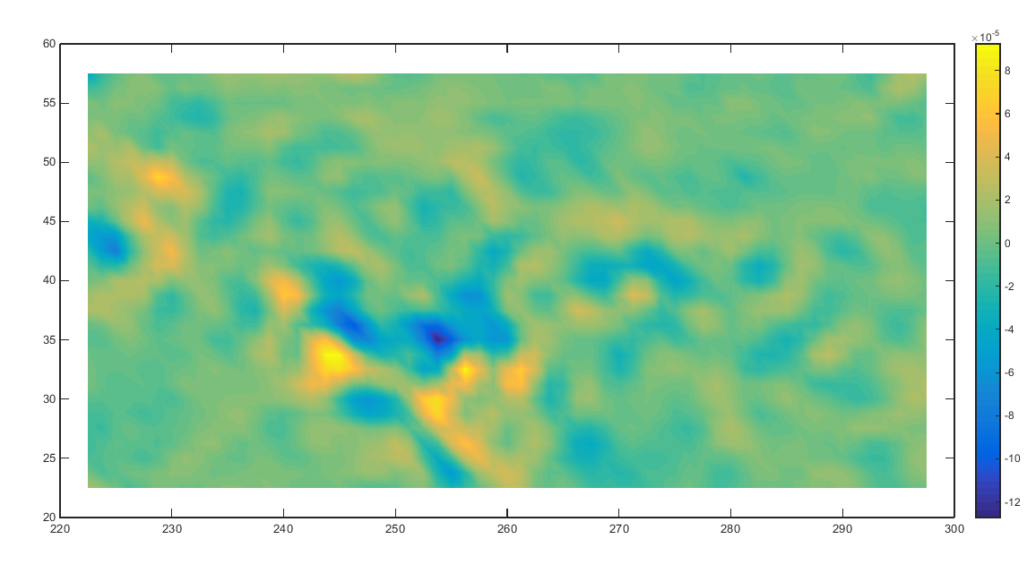
渦度 - 地轉渦度

Slide 17
為何槽底北側的渦度較地轉渦度小？
為何槽底南側的渦度較地轉渦度大？
離心力的加入導致準地轉不適用（力不平衡）
→ 氣流在槽底減速

Slide 18
注意事項:
Textbook HW2 deadline: 05/03 (This Wed.) 23:59
In-class problems 2 deadline: 05/03 (This Wed.) 23:59
Matlab HW2 (bonus) deadline: 05/10 (Wed.) 23:59
Mid-term exam 2 (Ch3 & Ch4) : 05/08 (Mon.) 08:10 – 10:00

